Slide 1
Unity Intro! To follow along and do this yourself you will need Unity Installed and working. (I’ll be using 5.2.4) Some assets we will use: (nothing fancy) http://csciclub.github.io/jeff/presentation%20assets.zip Everything we will do can be found at: http://csciclub.github.io/jeff/ball.zip http://csciclub.github.io/jeff/badmonty.zip (5.2.4 projects made on windows 10)

Slide 2
What is Unity?!??!?!??
Unity is a very awesome and free game engine that can be used to build games, apps, models, simulations ect.

Slide 3
What is Unity?!??!?!??
Unity is a very awesome and free game engine that can be used to build games, apps, models, simulations ect.

Slide 4
Cool things about Unity
Super fast deployment to many platforms
Just select which platform you want to build for and Unity takes care of it after you set it up.
Android, IOS, windows, mac, linux, others like xbox
Huge API with documentation that is extremely easy to read and find
Out of the box API integration with MonoDevelop.
Script in C#/javascript
Support for many common asset file types like .blend
Oculus rift support

Slide 5
Lets Make something!
Start Unity
New Project
Name it something
Click 3D
Create Project

Slide 6

Lets Make something!
Start Unity
New Project
Name it something
Click 3D
Create Project

Slide 7
Interface
Many sub-windows and tabs
Scene – This is where you place things in the 3d space
Game – The view from your main camera
Hierarchy – The list of every item in your scene
Project – File explorer for all files associated in your program. (images, scripts, animations, 3d models, sounds, videos, Pre made game objects)
Inspector – Displays information about the currently selected item in the hierarchy
Console – displays messages, like errors, warnings, printed statements from scripts.
There are some others for specific things like building animations, flow charts, and modifying sprites.

Slide 8
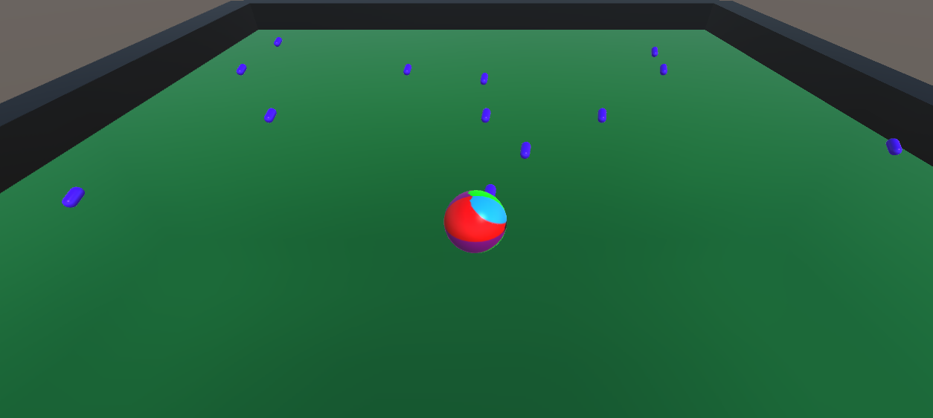
Our First Game!

Slide 9
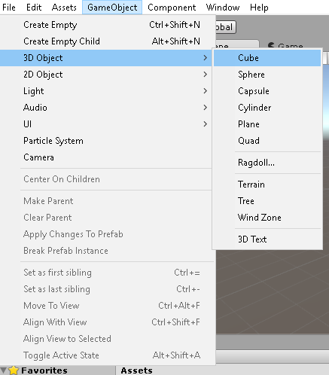
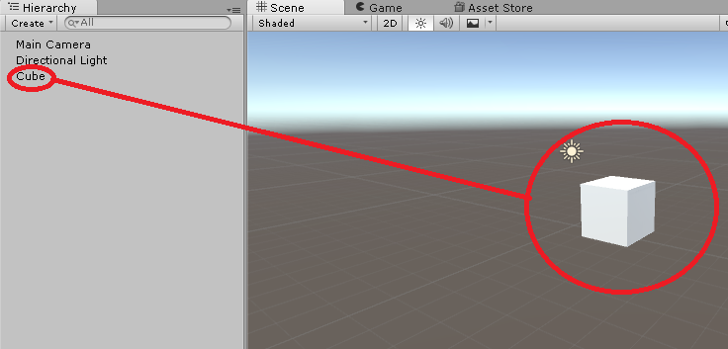
1 create the surface
Select GameObject → 3D Object → Cube
A 1x1x1 (unit unicube should now be in your scene!

Slide 10
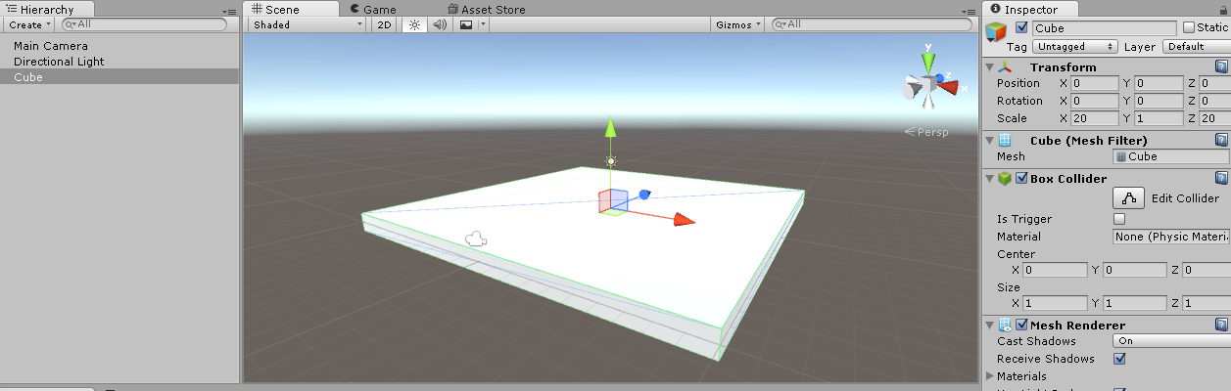
Create a 20x20x1 platform
In your Scene, or Hierarchy tabs select the newly created cube and look at the inspector. Under “Transform” scale the cube to (x=20, y=1, z=20)
Also Under “Position” move the cube to (x=0, y=0, z=0).
(if you want to focus on an object in the scene, select the object and with your mouse hovering over the scene window, and press F)

Slide 11
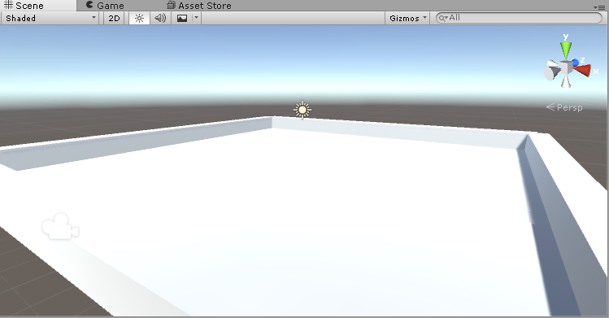
Walls
Similarly we will create 4, 20x1x1 walls around our platform.
Create 4 more cubes, scale each to (20x1x1), and alter their transforms so that they are around the platform.
Objects can be copy/pasted/cloned
Cube 1- P(0,1,10) R(0,0,0) S(20,1,1)
Cube2 – P(0,1,-10) R(0,0,0) S(20,1,1)
Cube 3- P(10,1,0) R(0,90,0) S(20,1,1)
Cube 4- P(-10,1,0) R(0,90,0) S(20,1,1)

Slide 12
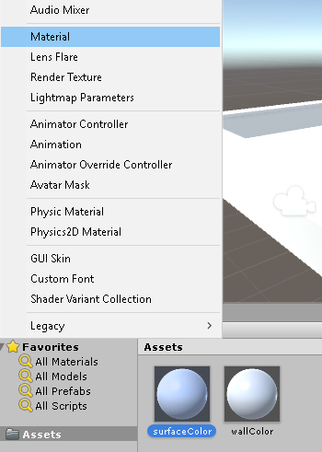
Materials
We should probably make use of the sweet graphics engine. Here we will add colors (materials) to each of our walls and surface. Materials are what we use to wrap 3D models. Here we will just use basic colors.
In the top left of the “Project” tab, select create→Material
Name the material something like “wall material”
And create another material for the surface.

Slide 13
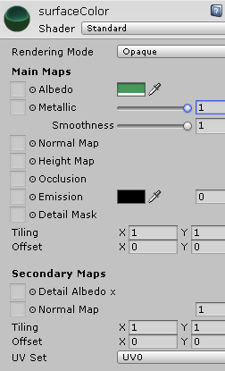
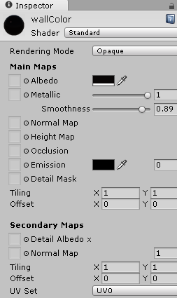
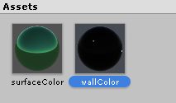
Materials
Select the wall material and take a look at the inspector window
Here we can use some tools to create edit the material we just created, lots of options for things like colors , shininess, and images that you want to put over your models.
Choose two colors you like =)

Slide 14
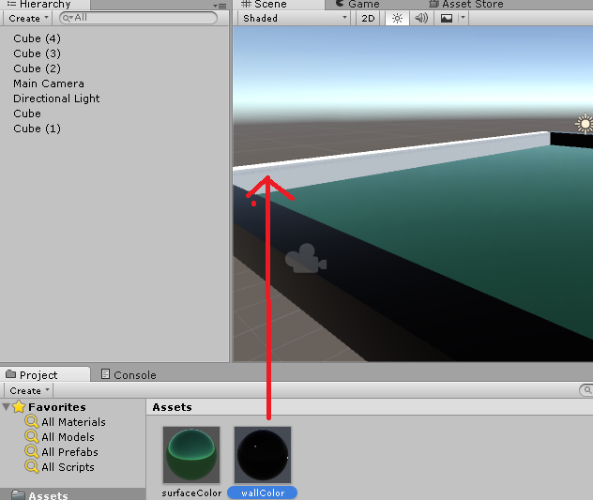
Materials
Drag these materials to the scene tab and drop them over the objects that you want to apply them to!

Slide 15
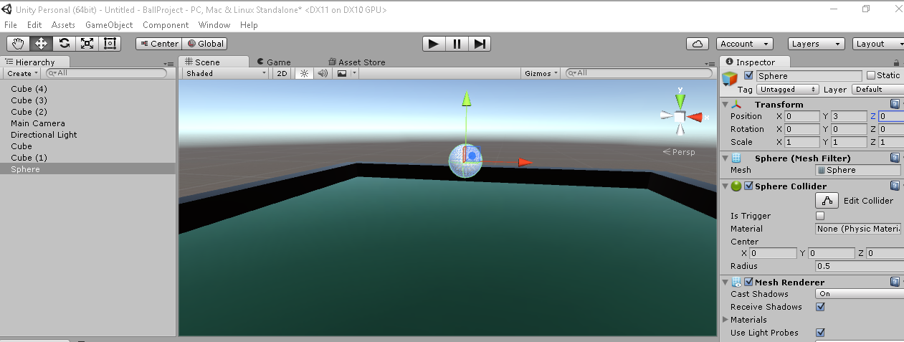
Creating the player!
We’re going to make a ball that will roll around when we control it
Select GameObject → 3D Objects → Sphere
Select the sphere and reposition it to (0,3,0)

Slide 16
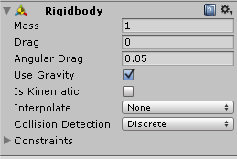
Adding the Player
If you press the Play button up top, you will see the view from the main camera, nothing much is happening here.
Un-play and select your sphere. We want the ball to fall when the game is live. So we need to make the ball an object that behaves according to Unity’s physics engine (you could roll your own physics too though)
Notice in the inspector you have several different components: Transform, Sphere mesh filter, sphere collider, mesh render and material. These are pretty self explanatory.
Select Add component → Physics → RigidBody
Your ball will now have a Rigid Body component, which makes it obey Unity’s laws of physics! Press Play and see! =)
Your ball stops because the box colliders of the floor and the sphere collider of the ball are colliding.

Slide 17
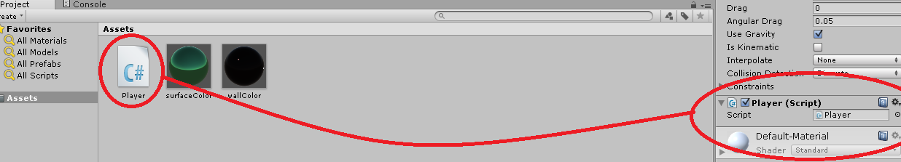
Adding the player
So now we have this ball that falls. The coolest thing that has happened in 14 slides..
Now lets figure out some controls!
Select the ball, AddComponent → New Script → name, csharp, create and add.

Slide 18

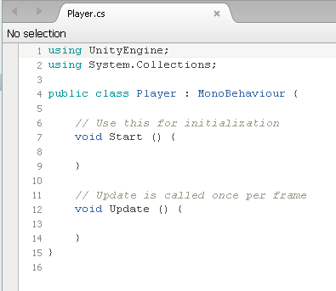
Unity Scripting
Finally some code stuff
Double click on the script you created :
This should open MonoDevelop if you let it install the way it wants to, idk about linux/Apply but if not any text editor will suffice, they’re just less integrated

Slide 19
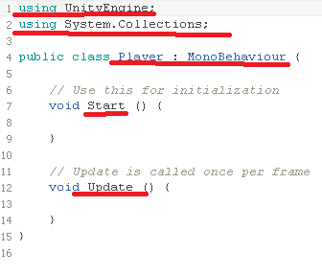
Scripts
The script will automatically create a new class that is the name of your script, include the default libraries, with a Start() and a Update() function these are inherited from MonoBehavior.
In the start function, you put everything you want to happen when the Game Object is first created or the play button is pressed.
The Update function is called once per frame, there is also a “FixedUpdate” function you could use instead that is synchronized with the draw rate I think.
In our start we will initialize things like speed and getting components that we will be manipulating.
In our update function we will do all of our things that will be happening over and over again, like checking for movement keys being pressed!

Slide 20
Scripts
Attaching a script to a game object makes its live, and it will be running as long as that game object exists in the scene. The script can immediately access the game object it is attached to by gameObject which is of type GameObject.
For example, gameObject.transform.position; is the 3d position of the object that has the script attached to it which is of type Vector3.
Members of vector 3 can be accessed by .x .y .z
For example Vector3 pos = gameObject.transform.position;
Debug.log(pos.x+” “+pos.y+ “ “ + pos.z +“\n”);

Slide 21
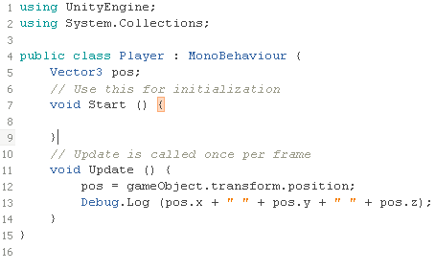
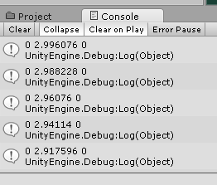
Scripts
Type and save the code to the right and press the play button in Unity.
In the console window you should see the position of the sphere being spammed.
One per frame is pretty frequently so you need to be careful about what goes into the Update function If you want decent performance.
Next lets make the ball move in the x direction.

Slide 22
Scripts
You can directly assign the gameObject.transform.position, however that might look choppy so we will apply a Force to the ball.
Forces can be applied to the Rigidbody component of the gameObject.
To get a specific component of a gameObject we will use the GetComponent<Template T>() function.
We will get the Rigidbody component by:
Rigidbody ballRigidBody;
ballRigidbody = GetComponent<RigidBody>()
And then we will be able to apply forces to that rigid body which will move the ball.

Slide 23
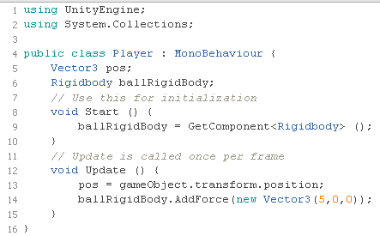
Scripts
Apply a force to the rigid body with AddForce(Vector3);
Press Play and see it go!

Slide 24
Scripts
Now we will add controls
We will use the flags of the form Input.GetKey(KeyCode.W)
This will be true of false for example if the W key is being pressed down, then the flag will remain true.
There is also GetKeyDown which will detect it being pressed down and GetKeyUp which will detect it being released.

Slide 25
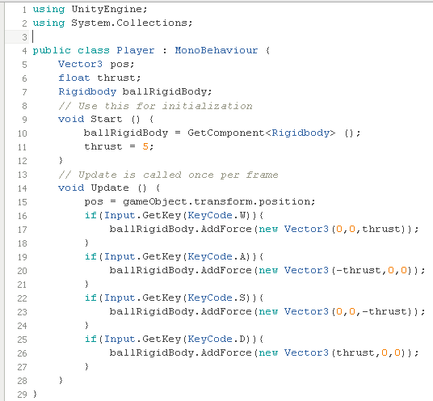
Scripts
Use the code to the right and press play.
You should now be able to control the ball in the scene!

Slide 26
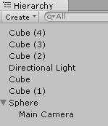
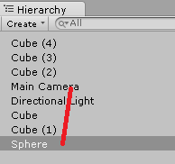
We can move! Its kinda like a game now!
Next, lets make the camera follow the player.
In the Hierarchy, drag and drop the main camera on top of the sphere.
Then press play/roll around!

Slide 27
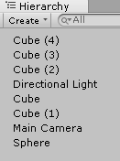
Camera following
As you can see, the camera is now rotating as if the sphere’s axes are the world axes. It’s rotation and position are relative to the sphere.
This isn’t very useful but it was worth a shot!
Move the camera back off of the sphere… by clicking and dragging.

Slide 28
Camera follow
Instead we will create a script on the camera that will update the camera’s x and z position depending on the position of the player.
Here we will need to access the Transform of a game object that our script is not attached to. We can do this by the function GameObject.Find(name)
Select the camera, add component → New Script → camerafollow c# add
Open the script in your text editor.

Slide 29
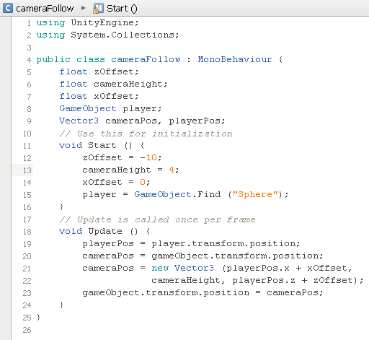
More scripts
We will obtain the position of the player, and we will assign the camera’s position to a position depending on the players x and z coordinates.
The script to the left will position the camera relative to the player.
Press play and check it out!

Slide 30
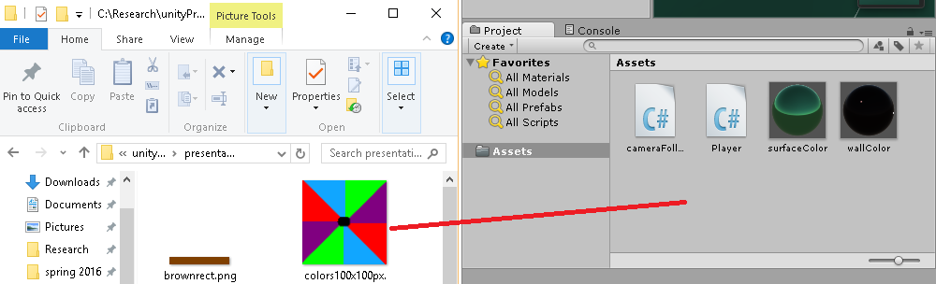
Add color to the player
The ball is rotating even if it doesn’t seem like it. Here we will add an image to be the material for the ball.
Drag and drop the colors100x100.png image in the assets folder or any other image you want into the Unity Projects window:

Slide 31
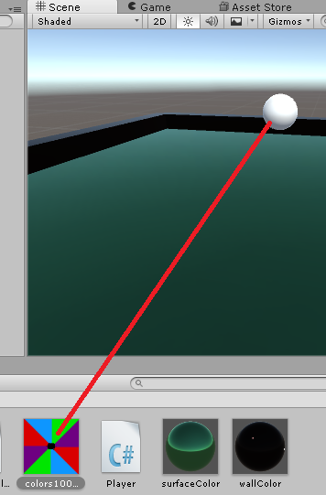

Adding color to the player.
Next Drag the image into the scene window and drop it on top of the sphere. This will automagically create a new material and apply it to the sphere! The material will have the image attached to it. (you might need to move the directional light away from your ball.)
This is a good example of how images might wrap on 3D objects in ways not immediately obvious. (kinda important to know about if you have complex models like people)

Slide 32
Now to add collectables
So now we can roll around our arena and run into walls with our colorful ball.
Next we will create objects that we will place around the arena. When the player runs over these objects they will be destroyed and the player will grow in size.
First, create a new 3D object in the scene like before Game Objects → 3D Object → capsule is what we will use.

Slide 33
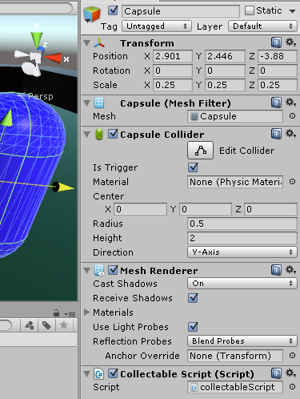
Creating a collectable
After creating the new object, create a new material for it and apply the material so that it has an interesting color.
Next, scale the object to (0.25,0.25,0.25)
Then, under the inspector → capsule collider, check “Is Trigger” This will make the collider non-solid so that things can pass through it. However we will be able to detect in scripts when colliders intersect the trigger.
Finally Crate a script for the object, something like “collectableScript”

Slide 34
Collectable behavior
I ran out of time creating slides :((( (5:50pm) but will keep going

